Slide 1
Physician Unionization: Collective Bargaining from a Physician Perspective
Diomedes Tsitouras, AAUP-BHSNJ
The information provided in this document is not intended as, and should not be construed to be, legal or consulting advice. Physicians should seek legal advice regarding any legal questions.

Slide 2
What is Collective Bargaining?
“Collective bargaining is the process in which working people, through their unions, negotiate contracts with their employers to determine their terms of employment, including pay, benefits, hours, leave, job health and safety policies, ways to balance work and family, and more. Collective bargaining is a way to solve workplace problems. It is also the best means for raising wages in America. Indeed, through collective bargaining, working people in unions have higher wages, better benefits and safer workplaces.”
-AFL-CIO

Slide 3
Why should Physicians Engage in Collective Bargaining?
Gives doctors a stronger voice and opportunity for communication in the healthcare workplace and beyond
Shifts power back to the doctor, especially economic power
Focuses on the needs of the doctor as an “employee”
A possible antidote that can be used to counteract high burnout/moral injury
Could help build membership

Slide 4
ABOUT AAUP-BHSNJ
The American Association of University Professors – Biomedical and Health Sciences of New Jersey (AAUP-BHSNJ) is an independent, non-profit organization that represents 1400 faculty at Rutgers/Rowan Universities. These faculty teach the next generation of doctors, nurses, scientists, and health professionals. The Association furthers the interests of faculty by bargaining for improvements in clinical compensation, researcher incentives, work/life balance, and other benefits. We also defend members from discriminatory treatment and provide individual advice on an array of issues. Finally, we advocate for our students, patients, and colleagues in Trenton by advancing legislation which promotes their interests.

Slide 5
What has our Union (AAUP) Accomplished Through Collective Bargaining?
Improved minimum pay standards based on AAMC benchmarks.
Bargained Better use of wRVU data tables (MGMA etc.).
Created mechanisms to reduce gender-based and arbitrary pay inequity.
Enhanced access to childcare, parental leave and other policies that support better work-life balance.
Moved faculty to longer appointment periods with greater job security.
Reduced the use of overly-broad restrictive covenants in appointment letters.
Stopped increases to health insurance premiums.
Strengthened health and safety protections.

Slide 6
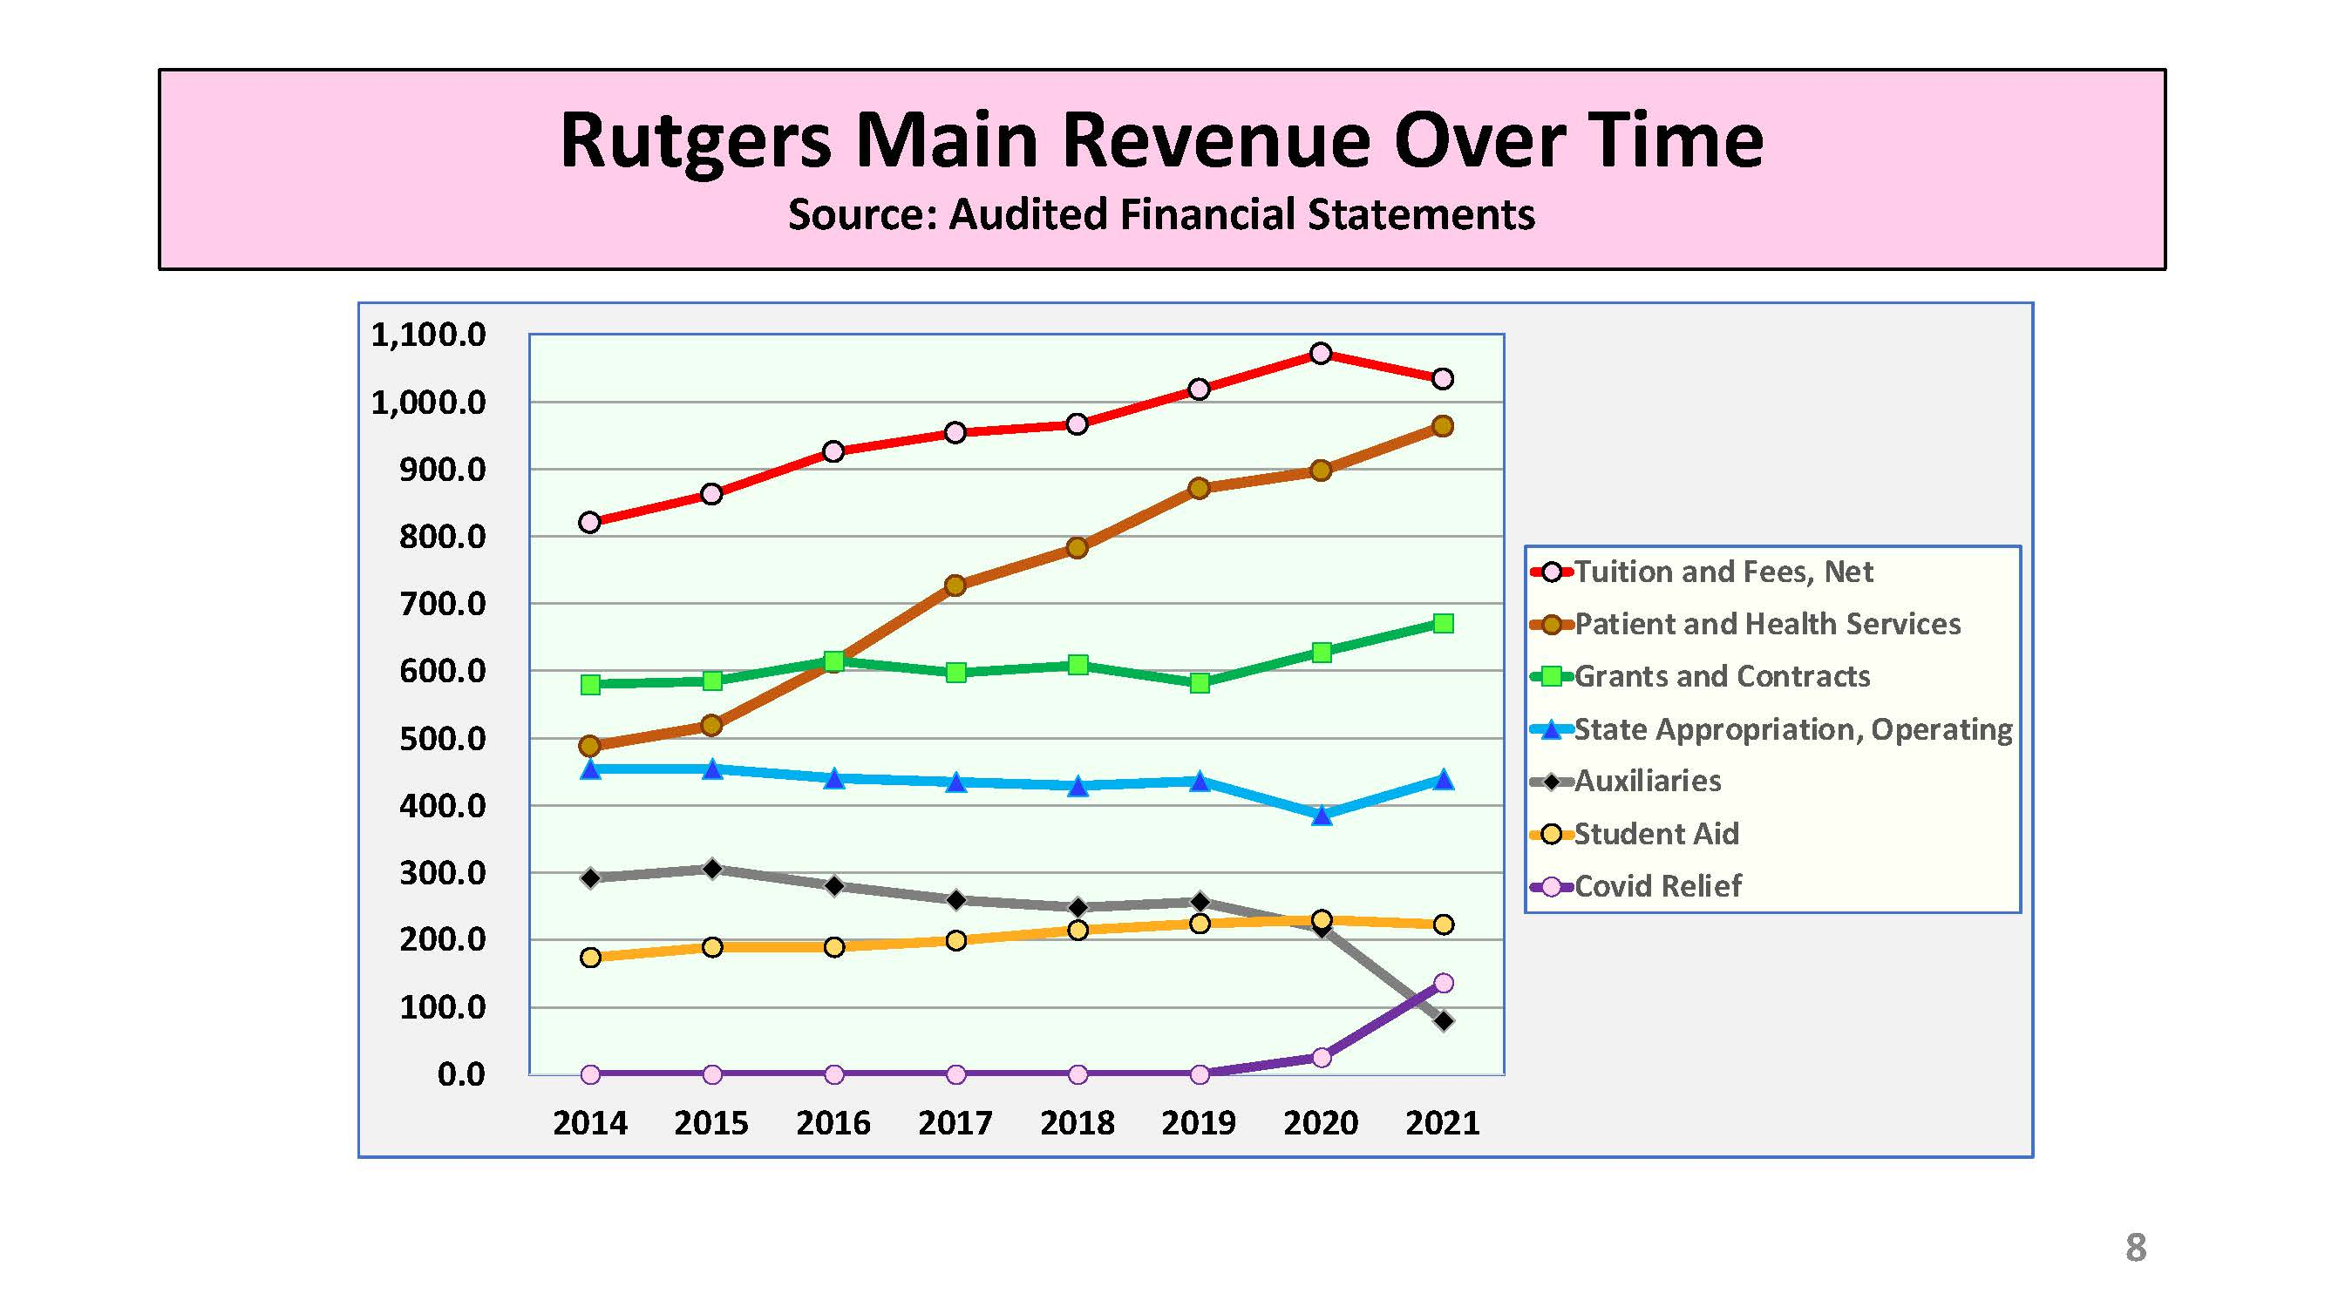
How much money do Universities receive from patient care?

Slide 7
Current Issues AAUP-BHSNJ is Bargaining or Grieving
The addition of a Fully Variable Supplement, an additional component of pay based on wRVU productivity
Anesthesiology call pay
Pathology clinical incentives
Losses of pay associated with the Change Healthcare cyberattack
Arbitrary pay inequity between members
Purported overpayments made to members by the University

Slide 8

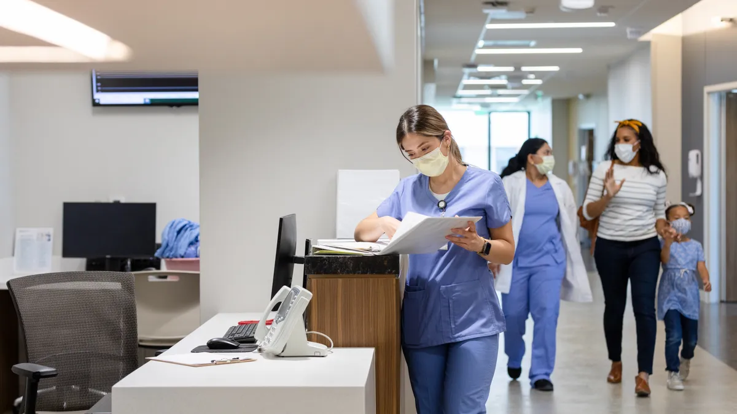
Doctors unionize as healthcare services are consolidated into corporate systems
– PBS Newshour January 1, 2024

Slide 9
Physicians and the National Labor Relations Act
Employed physicians who are not supervisors have the right under the NLRA, to self-organization, or form, join and assist labor organizations, to bargain collectively through representatives of the own choosing, or to engage in concerted activities
No formal union required for certain NLRA protections
Physicians-in-training
Physicians Who Are Supervisors and Not Protected by the NLRA
Self-Employed Physicians

Slide 10
How are Unions Formed and Contracts Negotiated?
Card drive by which a majority of employees in a “unit” sign cards asking for a single entity to be their “exclusive representative” or voluntary recognition by the employer
A “unit” can be any group of employees who are “logically placed together” for the purposes of collective bargaining.
Where there is no voluntary recognition, the National Labor Relations Board (or comparable labor board) schedules an election where all “unit” members vote either in favor of creating the exclusive representative or against it.
Assuming a favorable outcome for exclusive representative, such entity then bargains a contract with the employer covering bargainable terms and conditions of employment. Such entity is usually made up of certain employees of the unit who form a bargaining committee for the purposes of such negotiations.
Once contract negotiated, typically such contracts will contain a grievance procedure by which terms can be enforced.

Slide 11
Physician Unions (Collective Bargaining) as One Way to Combat Excessive wRVU Driven Expectations and Large Health System Power
Given that there are more employed physicians than in decades prior, physicians are increasingly using collective bargaining to protect their well being and to push back against risk-based-wRVU pay mechanisms.
Antitrust challenges that existed in the 1990s may not exist today with big health systems/different economic landscape.
The Moral Crisis of America’s Doctors – “The corporatization of health care has changed the practice of medicine, causing many physicians to feel alienated from their work.” New York Times, Eyal Press, June 15, 2023
Addressing Private Equity and Related Expectations
“Cardiology practices have become the latest fixation of private equity firms looking to profit from them. Ever since Medicare began paying doctors to perform common procedures in less expensive outpatient settings, financial investors have been racing to buy up cardiology practices. Experts fear that private equity's growing stronghold in the industry could exacerbate the overuse of cardiovascular procedures that are actually unnecessary for patient” -WBUR

Slide 12
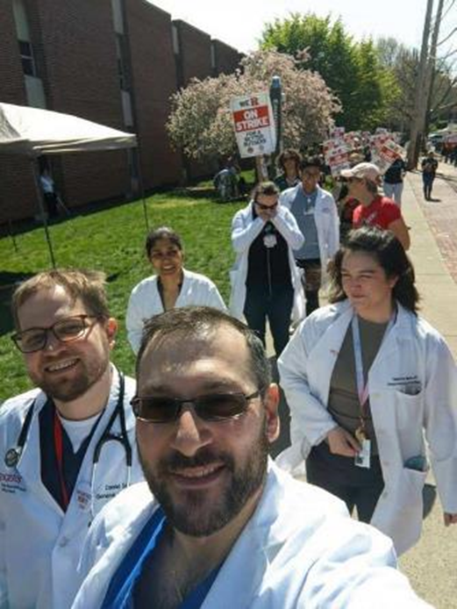
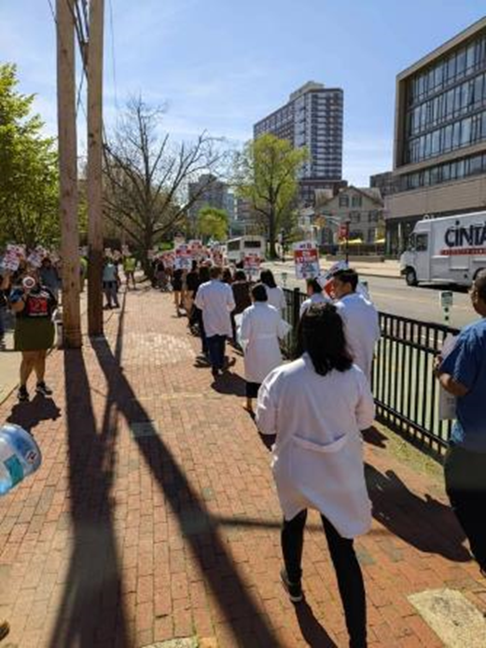
Will Doctors Have to Go on Strike?
Rutgers unions picket as medical faculty remain frustrated at lack of contract progress (NorthJersey.com)

Slide 13
Will Doctors Have to Go on Strike?
No.
Strikes are very rare among doctors and employees in general.
There are multiple ways of exercising collective power or gaining leverage in a negotiation. Striking is only one of them.
Your local union leadership will likely take a strike vote of members before striking. If such votes don’t get at least 90% of members agreeing to strike, a strike is not likely.
Patient safety is always taken into consideration. Actually, the law mandates notice to the employer before striking for this very reason.
Sometimes a union contract or the law will prohibit striking.
Some evidence that in the rare situations where healthcare workers do strike, patient health conditions and mortality actually improves.

Slide 14
Are there Challenges Physicians Face in Forming Unions?
Yes.
Employer may mount anti-union campaigns. (See Amazon, Starbucks)
Sometimes labor relations law is old and weak.
Occasionally forming a union or negotiating a contract may take time.
Given poor union density, doctors lack familiarity with unions, how they work, and what they do
Mythology around unions
Dealing with special provisions physicians may already have within individual employment contracts
However, education and empowerment is the first step for any physician using collective bargaining as a tool. The above challenges should not prevent those interested in forming unions from doing so.

Slide 15
How can the AMA or Medical Societies Engage with Collective Bargaining and Support the Physician Employee?
Nursing Associations as a model? Way to boost membership?
Partnering with existing national unions which have expertise?
Not all organizing drives need to be large.
Short of organizing, the AMA and medical societies can foster norms and culture that supports employment rights and physician unions.
Provide resources, know-your-rights trainings, and mutual-aid type services for doctors as employees.
Support local efforts to organize healthcare workers when they occur.
Use its influence and unique role with accrediting medical schools to foster employment rights within the medical school.
Support federal and state legislation that enables physician collective bargaining and stronger employment rights which benefit physicians and other healthcare employees.

