Slide 1

No Deference?
Healthcare Regulation and the
Demise of Chevron

Slide 2

Olden Times

Slide 3
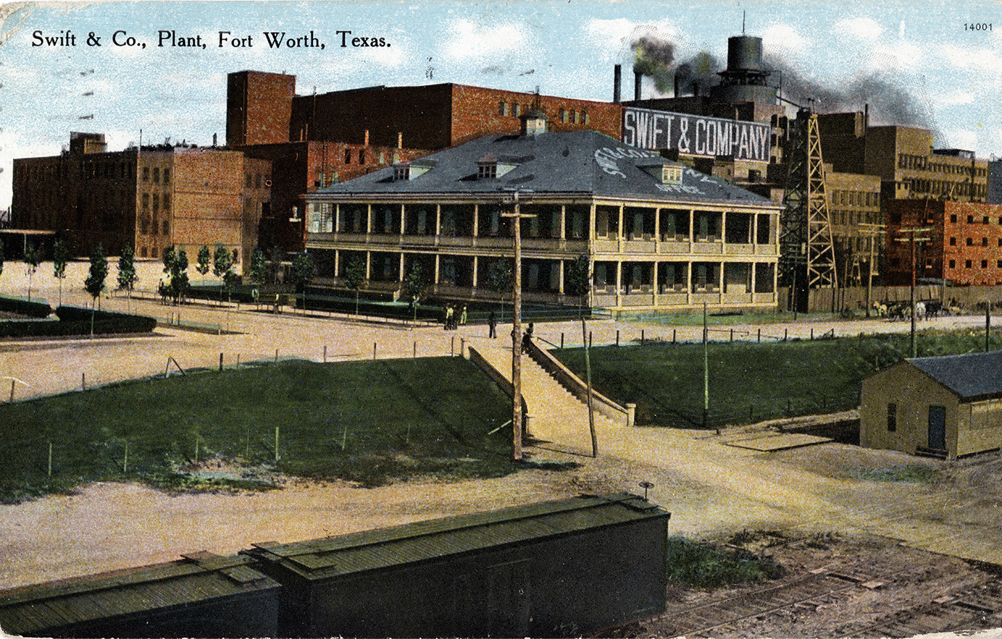
Skidmore v. Swift (1944)

Slide 4
Skidmore v. Swift (1944)
“We consider that the rulings, interpretations, and opinions of the Administrator under this Act, while not controlling upon the courts by reason of their authority, do constitute a body of experience and informed judgment to which courts and litigants may properly resort for guidance.”

Slide 5
Skidmore v. Swift (1944)
“The weight of such a judgment in a particular case will depend upon
the thoroughness evident in its consideration,
the validity of its reasoning,
its consistency with earlier and later pronouncements,
and all those factors which give it power to persuade, if lacking power to control.”

Slide 6
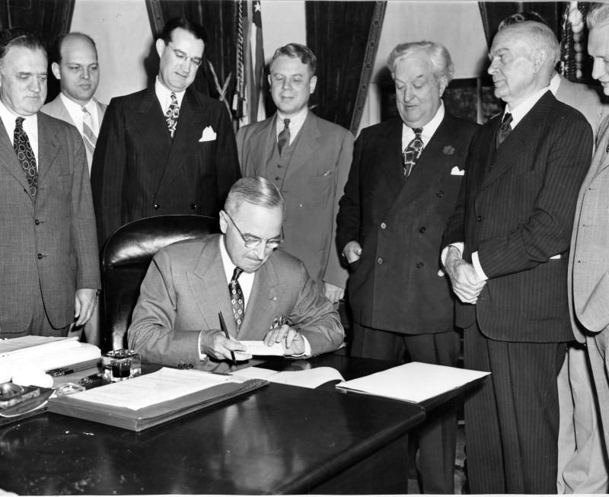
Administrative Procedure Act

Slide 7

Chevron U.S.A. v.
Natural Resources Defense Council (1984)

Slide 8
Chevron Two-Step
Step One: Has Congress “directly spoken to the precise question at issue”?
Yes: The court “must give effect to the unambiguously expressed intent of Congress”
No, the statute is silent or ambiguous: Go to Step Two
Step Two: Is the agency’s action “based on a permissible construction of the statute”?

Slide 9

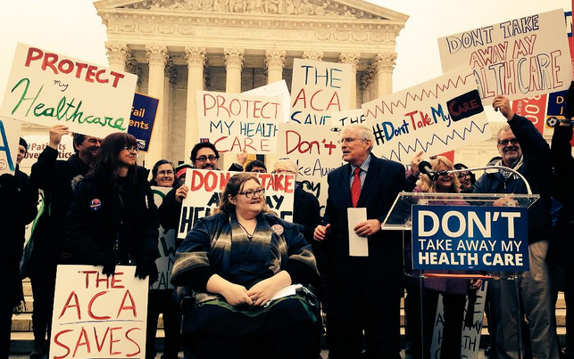
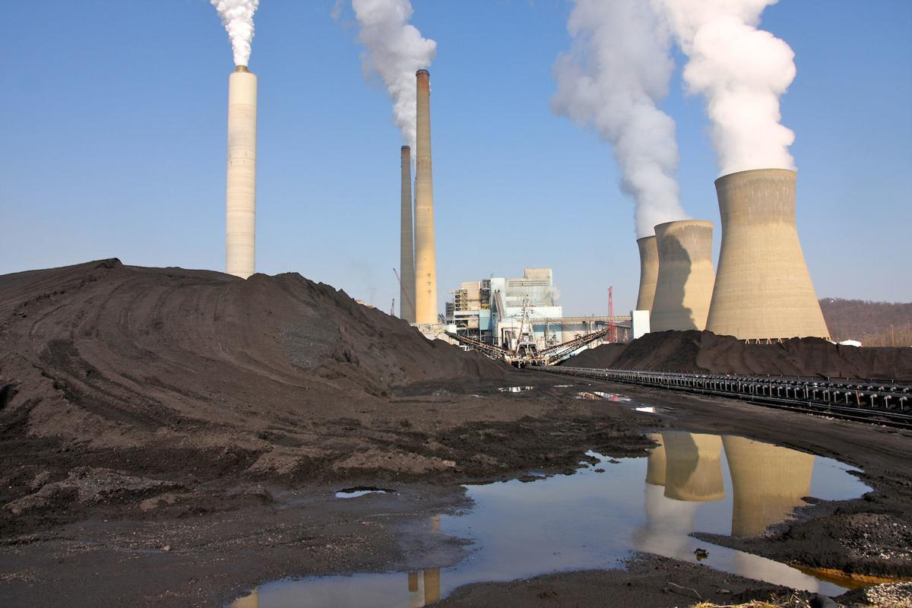
Major Questions Doctrine
FDA v.
Brown & Williamson (2000)
King v. Burwell
(2015)
West Virginia v. EPA
(2022)

Slide 10
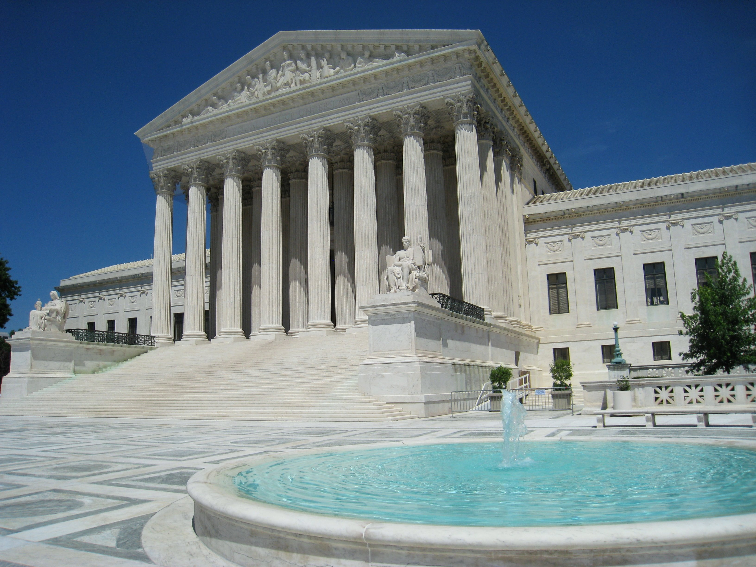
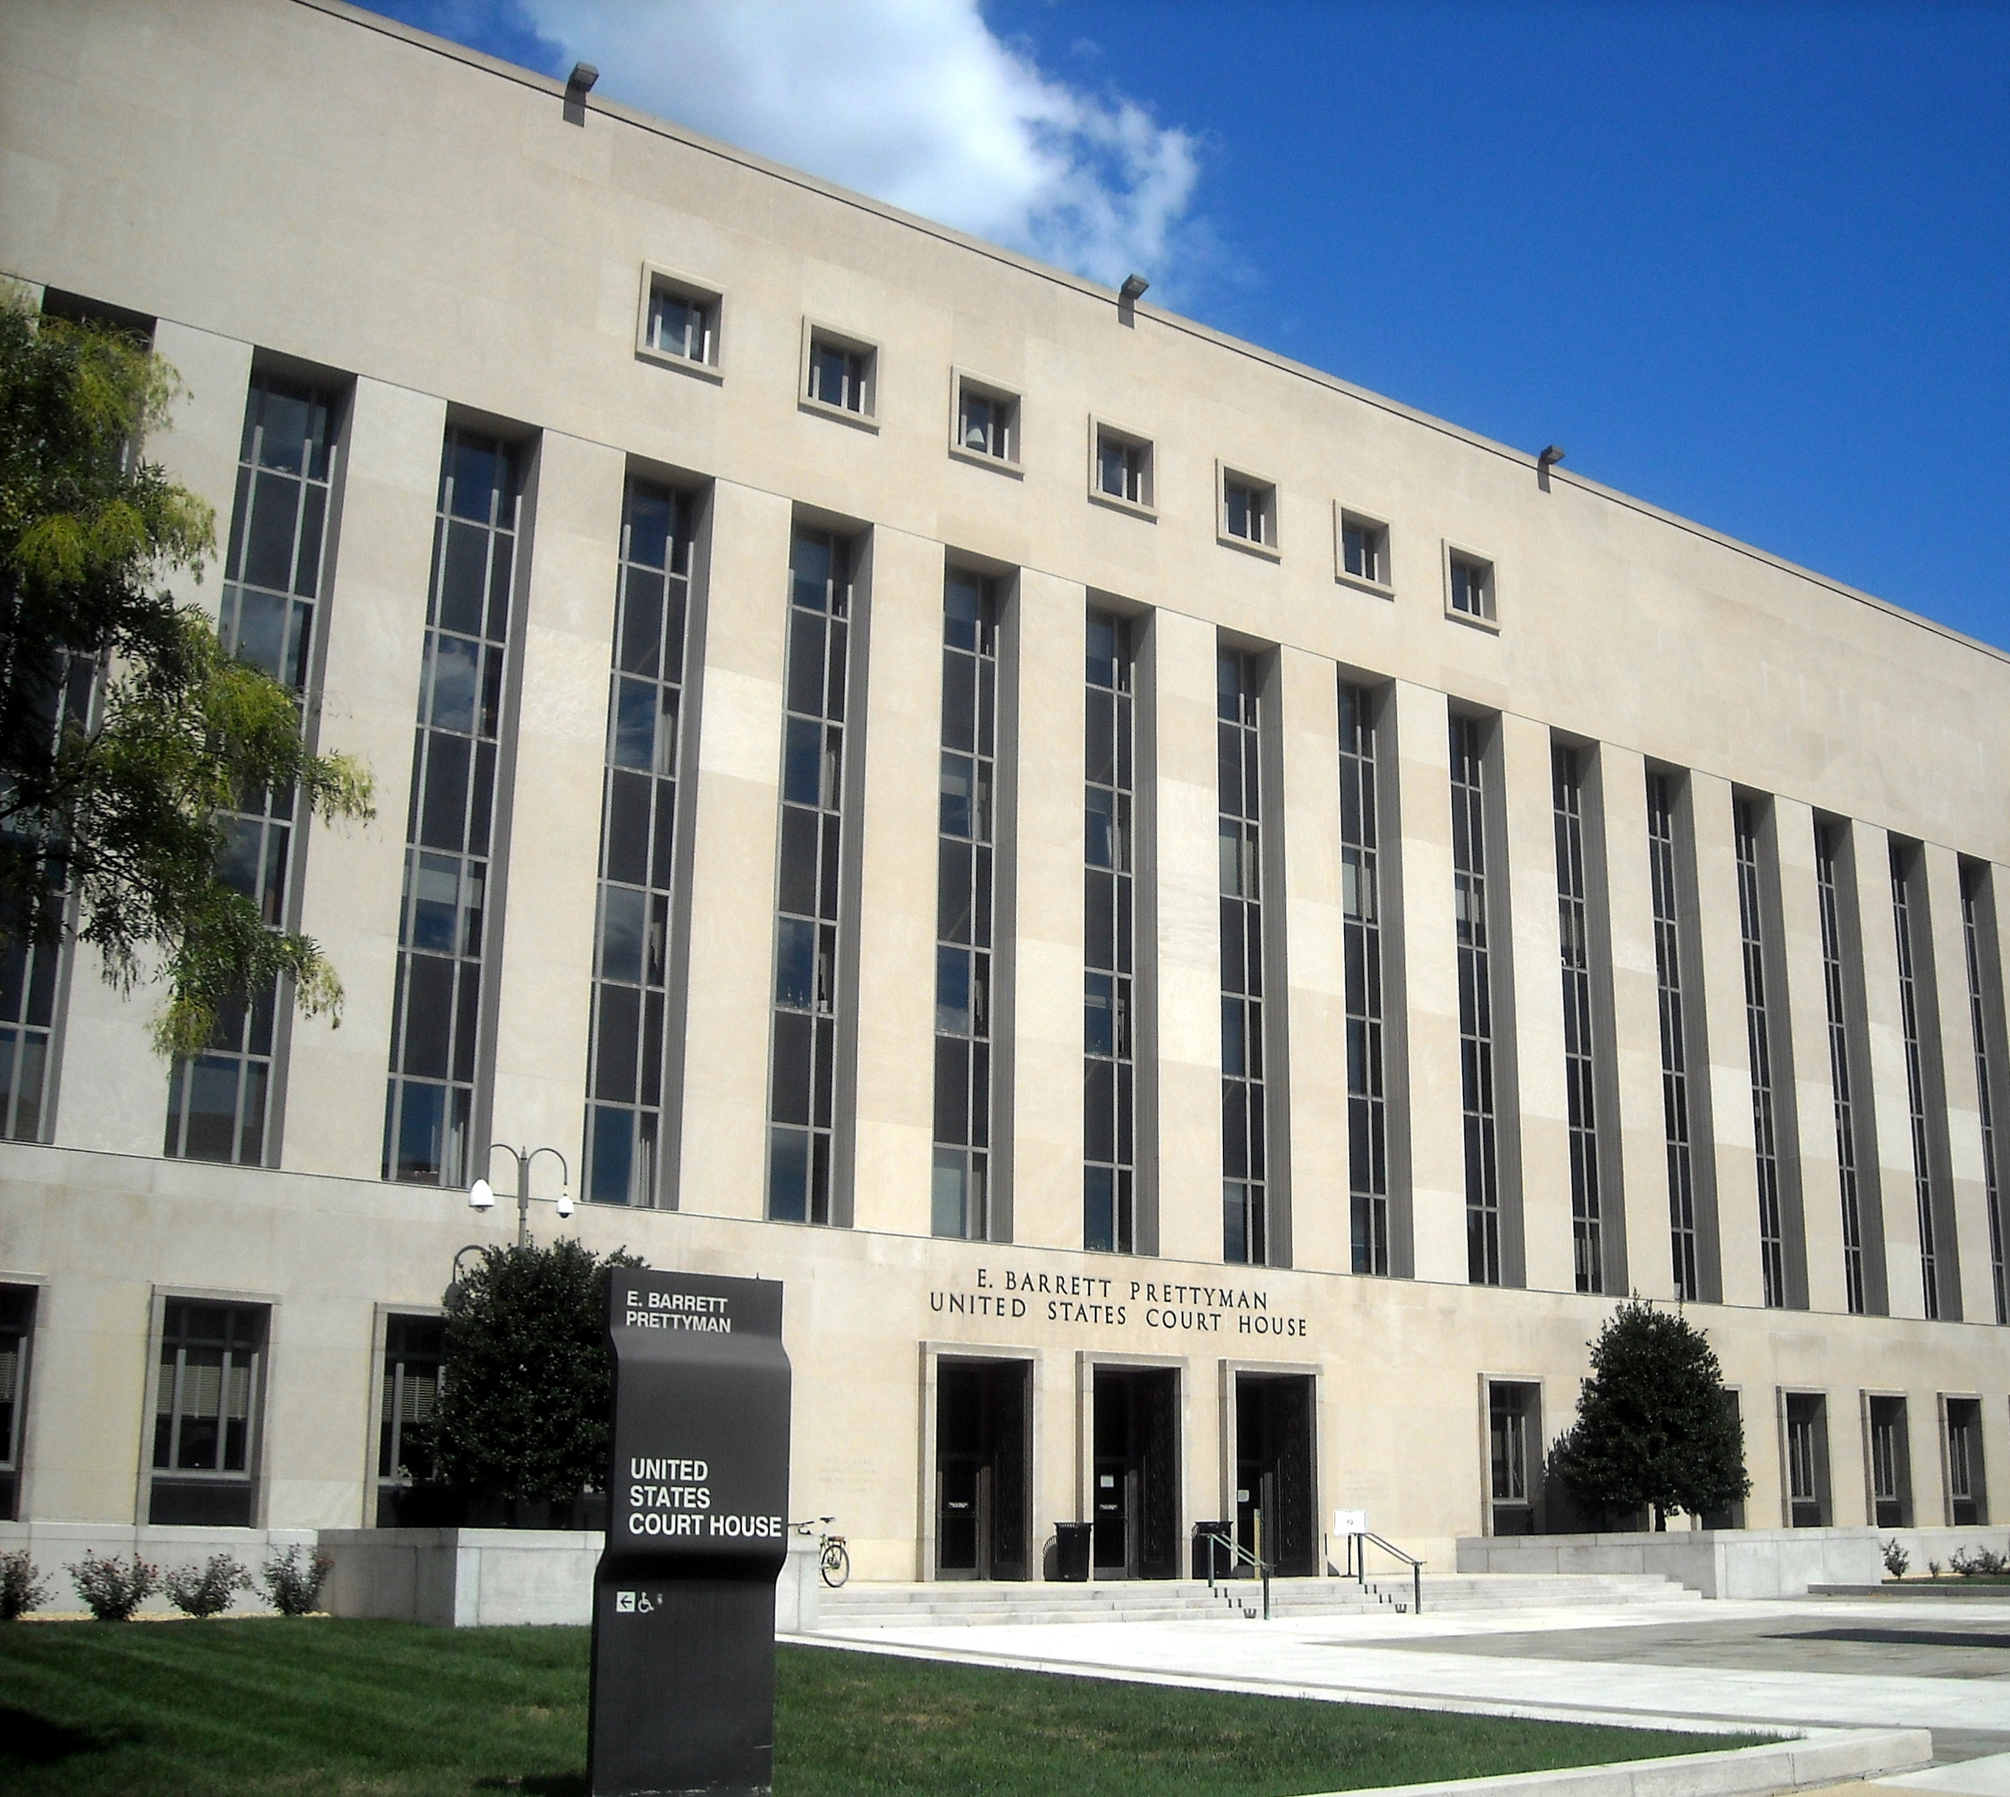
Did Chevron Matter?

Slide 11

Loper Bright Enterprises v. Raimondo

Slide 12
Loper Bright Enterprises v. Raimondo
“By forcing courts to instead pretend that ambiguities are necessarily delegations, Chevron does not prevent judges from making policy. It prevents them from judging.”

Slide 13
Loper Bright Enterprises v. Raimondo
“[W]e do not call into question prior cases that relied on the Chevron framework. The holdings of those cases that specific agency actions are lawful—including the Clean Air Act holding of Chevron itself—are still subject to statutory stare decisis despite our change in interpretive methodology.”

Slide 14
Loper Bright Enterprises v. Raimondo
“Under the Public Health Service Act, the Food and Drug Administration (FDA) regulates ‘biological product[s],’ including ‘protein[s].’ 42 U. S. C. §262(i)(1). When does an alpha amino acid polymer qualify as such a ‘protein’? Must it have a specific, defined sequence of amino acids? See Teva Pharmaceuticals USA, Inc. v. FDA, 514 F. Supp. 3d 66, 79–80, 93–106 (DC 2020).”
Kagan, J., dissenting

Slide 15

Corner Post, Inc. v. Board of Governors

Slide 16


Nationwide Injunctions

