Slide 1
The State of Medical Professional Liability
Mike Stinson, JM Vice President, Public Policy and Legal Affairs October 8, 2024

Slide 2
Who we are
Represent the diverse MPL industry
Members insure all types of health professionals
Members operate in all 50 states and dozens of countries
Notes:
While we started as just mutual insurance companies, i.e. physician-owned and operated, we’ve diversified as the industry has changed. Now represent mutuals, RRGs, stock-based, trusts, captives, self-insured hospitals and health systems, and other insurers committed to the MPL line of coverage. Includes insurers in every state and numerous countries.
MPL Association members insure nearly 2.5 million healthcare professionals around the world—doctors, dentists, nurses and nurse practitioners, and other healthcare providers—including more than two-thirds of America’s private practicing physicians. MPL Association members also insure 3,000 hospitals and more than 50,000 medical facilities and group practices globally.

Slide 3
Notes:
The Data Sharing Project (DSP) collects and accumulates claims data from participating domestic member companies of the MPL Association, and its focus is to provide the intelligence needed to enhance risk management and patient safety in medicine and to track MPL claim costs. By the end of 2021, more than 323,000 closed claims and lawsuits were reported to the DSP, totaling in excess of $48.5 billion in indemnity and expense payments on more than 92,200 paid claims.

Slide 4
Costs of MPL Claims
Notes:
We group the data in 5 years bands to minimize anomalies (with so few claims, one “big” year could throw off averages). After adjusting for inflation, you’ll see that average indemnity payments increased from $288,000 in the first band to nearly $456,000 in the early 2000s. The subsequent decline in such payments has been attributed to many factors, including an increased focus on patient safety and the enactment of effective medical liability reforms in numerous states. Whatever the reason, indemnity payments declined for awhile resulting in a stabilizing of the insurance market. Most recently, however, the reduction in average indemnity payments stabilized, declining only modestly to $379,479 in the 2017–2021 time period (potentially attributable to the reduction in claims resolved through litigation during COVID-19-related court shutdowns). That is still a 32-percent increase in inflation adjusted dollars.
As noted previously, though, expenses continue to rise, with the recent decline being likely attributable to COVID-19-related court closures). Even with that, expenses per claim has nearly doubled, after accounting for inflation, over this time period.

Slide 5
Claim Values
Notes:
This figures shows an overview of claims closed by year at four indemnity-payment thresholds: $100,000, $250,000, $500,000, and $1,000,000 (in 2021 dollars). The percentage of claims with $1 million or more in indemnity payment has increased from approximately 7 percent of all paid claims in 1987 to more than 9 percent in 2021. Claims resulting in a payment of $500,000 or more have increased from 7 percent of total claims in 1987 to 11 percent in 2021. As one might expect, along with the upward shift in large dollar payments comes a consistent decline in the lower end of the spectrum where, from 1987 to 2021, indemnity payments of less than $100,000 have fallen from 53 percent of all paid claims to 40 percent of paid claims. It is, again, important to note that the shift to smaller payments in 2021 may simply reflect COVID-19-related delays in closing larger, more complex claims rather than indicating an actual shift in payment trends.

Slide 6
Impact on Medical Specialties
Notes:
When looking at individual specialties, you see that obstetric and gynecologic (Ob/Gyn) surgery had the most paid claims reported in the cumulative data (roughly 13,700 since 1987). This chart shows that total Ob/Gyn surgery payments approached $7.0 billion, substantially outpacing its nearest “competitor,” internal medicine, which came in at slightly over $3.5 billion in payouts (on approximately two-thirds the number of paid claims as Ob/Gyn surgery).
Neurological surgery reported the highest average indemnity over the course of reporting—$549,496 in 2021 dollars—but barely outpaced neurology ($553,765). Rounding out the top five in the average payment category were Ob/Gyn surgery ($508,697), pediatrics ($490,306), and radiation therapy ($450,052).

Slide 7
Escalating Damages
Nearly $47 million verdict won after Tennessee girl injured during birth
This is the largest verdict of its kind in Tennessee history
by Caleb Washington, WSMV, May 21, 2024 at 10:53 PM EDT
Rural Jury awards $47M medical-malpractice verdict
By Cedra Mayfield Law.com, August 8, 2024
Former lawyer who suffered stroke awarded $41 million in medical malpractice lawsuit
Craig Pierce, who lives in downstate Bushnell, is paralyzed on the left side of his body and has severe cognitive deficiencies as a result of the stroke.
By Cindy Hernandez Chicago Sun Times
MAY 10, 2024 — 8:15 PM EDT
Michigan mom, son awarded $120M in malpractice lawsuit over delayed C-section
by Christina Hall, Detroit Free Press
April 2, 2024, 11:51 p.m.
Philly jury hands down $182.7M med-mal verdict against UPenn Hospital, largest in Pa. history
By Nicholas Malfitano
Apr 28, 2023
Notes:
Outlier verdicts are increasing, for a variety of reasons. and not because of changes in the law. Awards in the low double-digit millions are now seeming somewhat tame.
Why are awards increasing? Lots of theories on that.

Slide 8
$10M+ Verdicts, 2012-23 Data known as of 3/31/2024

Slide 9
$25M+ Verdicts, 2012-23 Data known as of 3/31/2024

Slide 10
$100M+ Verdicts, 2012-23 Data known as of 3/31/2024

Slide 11
Social Inflation
Juries are changing
Trial lawyer tactics
Defense costs increasing
Some insurers more aggressive
Notes:
Juries view things differently, want to compensate even when no negligence (jury interview results). Athlete, entertainer and business executive salaries have distorted value of claims. Juries fine with large numbers. Plaintiff bar using new techniques to drive up awards – reptile theory, bullrush strategy, anchoring, etc. Life plans are unregulated and just wild guesses. Need to accept that old strategies may no longer work and look for new ways to counter these strategies. To adapt to these strategies, defense costs are increasing (experts, graphics, etc.). In some cases, larger awards are being issued because some defendants/insurers are getting more aggressive defending cases, opening themselves to more risk.
Now, you may be thinking, how relevant are these factors. Even if a jury gives an inappropriate 9-figure award, it gets reduced on appeal. Sometimes, but that original 9-figure award is what trial lawyers will advertise. It’s what will be communicated by the media. And it will plant in the public’s head (i.e. future jurors) what numbers are appropriate. Also will sway future plaintiffs to ask for more, and drive settlements higher.
At same time, plaintiffs bar is seeking to alter the playing field by eliminating or negatively modifying many tort reforms.

Slide 12
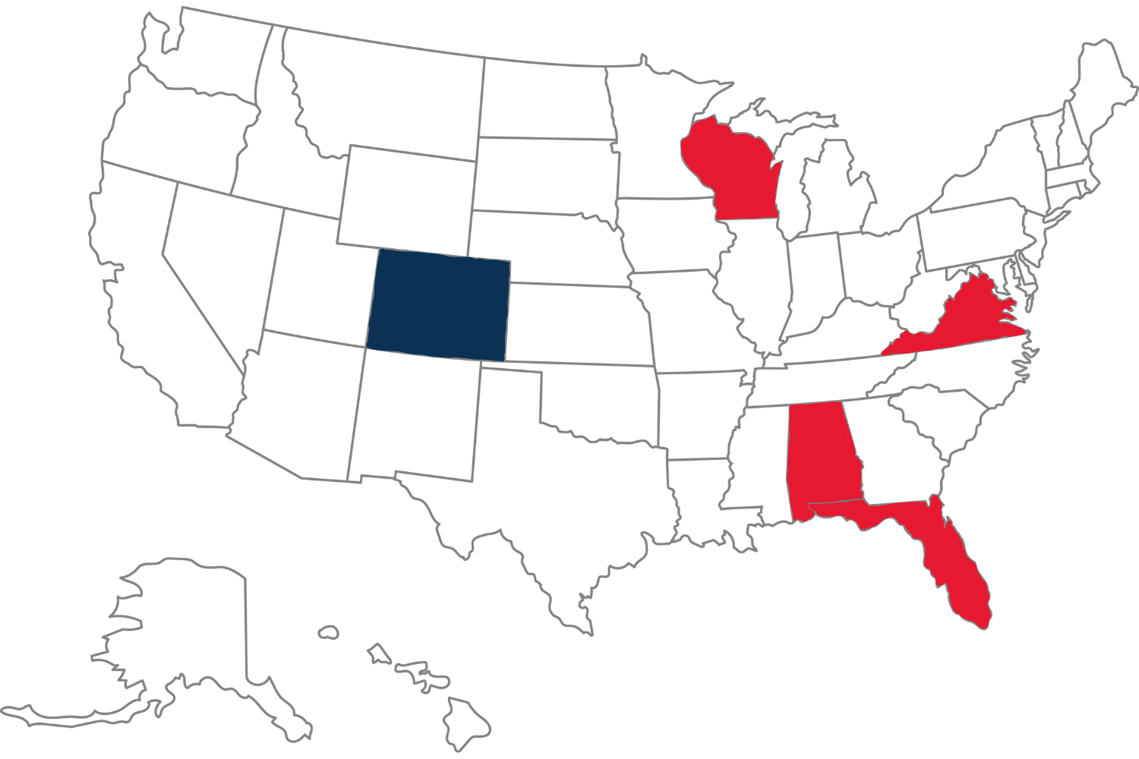
Damage Caps - 2024
Colorado (2024)
Raises nonecon cap from $300k to $875k over 5 years
Adjusted every two years for inflation starting 1/1/2030
Failed efforts
FL (SB 248) – Establish $500k/$750k cap
AL (SB 293) – Establish $1M cap
WI (AB 872) – Increase cap to $3M
VA (SB 493) – Eliminate caps for children <11
Notes:
CO – Ballot initiative to gut caps (competing initiatives filed). Our side promoted bill with $500k cap, which passed committee. Finally negotiated bill with this cap. Also increased wrongful death and total cap.
FL – Part of a bill allowing damages for adult children or parents of adult children. Compromise.
AL – Part of bill limiting TPLF. No idea if will be pursued next year.
WI – Cap is $750k, so big jump. Likely to be pursued again, but not clear on legislative interest.
VA – Total cap state. Bill had momentum, but died suddenly in committee. Sponsor committed, so expect to see it again

Slide 13
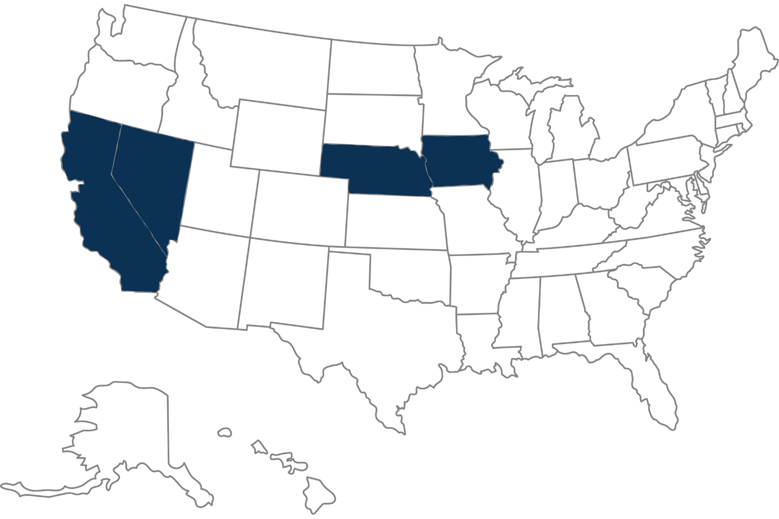
Damage Caps – 2023/2022
Iowa (2023)
Capped damages for severe injuries
$1M for physicians/$2M for hospitals
Nevada (2023)
Increases cap from $350K to $750K (over 5 years)
2.1% annual increase thereafter
Nebraska (2023)
Increased cap from $500K to $800K
PCS kicks in over that amount
California (2022)
Raise cap to $350k for injuries/$500k for death; increases to $750k/$1M, then inflation
Periodic payment threshold increased to $250k
Notes:
CO – Attempt to battle ballot initiative. Passed by committee which is increasing pressure on plaintiffs bar to negotiate. Increase over 5 years.
FL – Part of a bill allowing damage for adult children or parents of adult children. Compromise.
AL/WI – No idea if any momentum.
CA – arguably what started it all. Also increased for wrongful death.
Future – We expect efforts to the positive in GA, to the negative in VA, MT, MI. Any states with a citizens initiative process is a target.

Slide 14
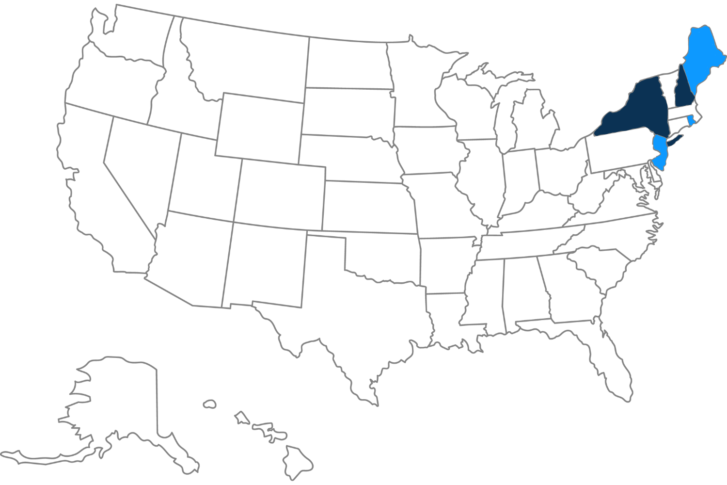
Wrongful Death
New Hampshire
Increases wrongful death cap
$500k for an adult/$300k for a child
New York (pending)
Expands family members who may file claims
Creates damages for “grief and anguish”
2023
Maine – Increased wrongful death cap from $750K to $1M, w/annual inflation adjustments
New Jersey – Expands eligibility to file claims
Rhode Island – Increases floor from $250K to $350K
Notes:
NH – Originally removed cap. Amended to Increase adults from $150k to $500k, from $50k to $300k to parent (if decedent is child) or child (if decedent is parent)
NY – Grieving Families Act – twice vetoed but legislature keeps pushing with few changes.

Slide 15
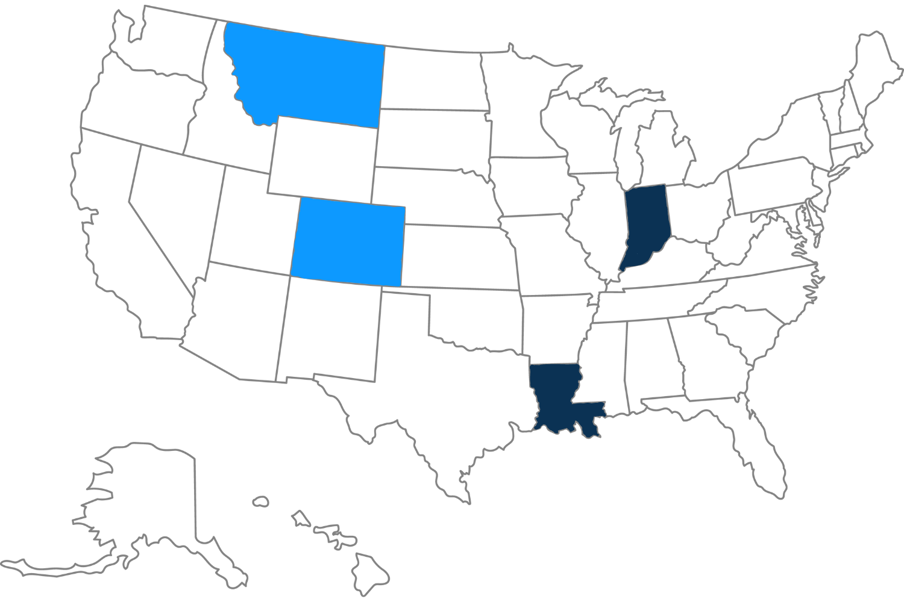
Third Party Litigation Funding
Indiana
No involvement in case; discoverable
Louisiana (foreign lenders only)
Mandates disclosure of funding agreements
No involvement in case
2023
Indiana – Mandates disclosure of funding arrangements
Montana – Mandates disclosure of funding arrangements
Colorado – Regulatory reform proposal drastically weakened
Louisiana – Disclosure bill vetoed
Notes:
Indiana passed the only broad bill this year, while LA was limited to foreign entities. Becoming a big issue in the legal system, but not clear yet on what it means for MPL.

Slide 16
Other Issues
Phantom damages
Statutes of limitations
Prejudgment interest
Communication & Resolution Programs (CRPs)
Anti-anchoring
Notes:
Didn’t see all of these in 2024, but we expect them to keep coming.

Slide 17
Questions
Mike Stinson, JM
Vice President, Public Policy and Legal Affairs
mstinson@MPLassociation.org
240.813.6139

