Slide 1

Reproductive Healthcare
Across State Lines
Annalia Michelman
Senior Attorney
AMA Advocacy Resource Center

Slide 2
State Abortion Bans (as of October 7, 2024)
 | Conception (13 states)
 | 6 weeks (3 states)
 | 12 weeks (2 state)
 | 15 weeks (1 state)
 | 18 weeks (1 state)
 | 22 weeks (4 states)
 | Viability or later (17 states)
 | No gestational limit (9 states and DC)
Notes:
Abortion landscape is paradoxical.
On one hand, nearly half the states ban abortion.
In those states, abortions have dramatically decreased.
Example: Texas reported a 99.9% drop in two years since Dobbs. Average per month now is five.
Seems like lawmakers in ban states have succeeded in their objectives. Except…

Slide 3
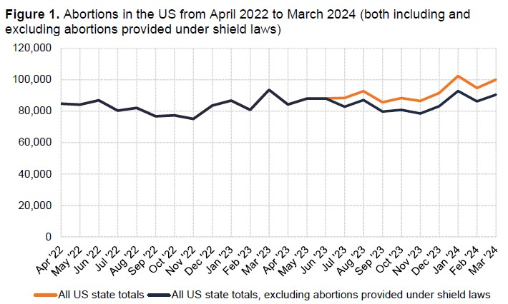
Since the Dobbs decision, the total number of
abortions provided per month has increased.
Source: Society of Family Planning, #WeCount Report, April 2022 to March 2024, Released August 7, 2024
Notes:
The Society for Family Planning #WeCount initiative tracks abortions on a monthly basis.
Abortion volume has been higher in 2024 than it was in 2023 or 2022.
In the three most recent months of data collection, January 2024 to March 2024, #WeCount reported an average of 98,990 abortions.
In June 2022, the monthly total was 86,830.
Reasons for increase:
better access in states where abortion remains legal,
patients travel to other states for abortion care.
Clinics in border states have seen spike in volume.
medication abortion via telehealth
Abortions provided via telehealth now account for 20% of all abortions, about 19,700. Of those, 9,200 are provided to patients located in states that ban abortion or ban abortion via telemedicine. Providers of that care are operating under the protection of shield laws.

Slide 4
State Shield Laws for Abortion Care (as of October 7, 2024)
 | Shield law enacted (18 states and DC)
 | No shield law (32 states)
Notes:
Since 2022, 19 states, including DC, have enacted shield laws. They vary by state but generally speaking, shield laws are intended to protect providers and patients in access states from extraterritorial enforcement of or investigations related to other states’ abortion bans.
Most extend some or all protections to gender-affirming care.

Slide 5
Shield Law Protections
Out-of-state Legal Actions or Investigations
Professional Disciplinary Actions
Insurance Actions
Confidentiality
Civil Liability
Notes:
Protections against out-of-state actions or investigations - extradition, arrests, search warrants, subpoenas, witness summons, and use of state resources
Protections against professional Disciplinary actions – medical board discipline, hospital privileges
Protections against civil liability - judgments from other states, cause of action against someone who initiates action or interferes with protected healthcare
Protections against adverse actions by liability insurers and health plans – refusal to issue/renew policies, network contracting
Confidentiality - disclosure of medical information, providers’ personal information

Slide 6
State Shield Laws for Abortion Care (as of September 27, 2024)
 | Shield law enacted (18 states and DC)
 | Shield law protects out-of-state telehealth (8 states)
 | No shield law (32 states)
Notes:
Generally, the practice of medicine is governed by the laws of the state where the patient is located when the care is provided.
Massachusetts was first state to extend protections to out-of-state care. Statutory protections exist “regardless of the patient’s location” if provider is physically located in Massachusetts, licensed in Massachusetts, and in compliance with the laws of Massachusetts.
Eight other states have followed this trend.

Slide 7
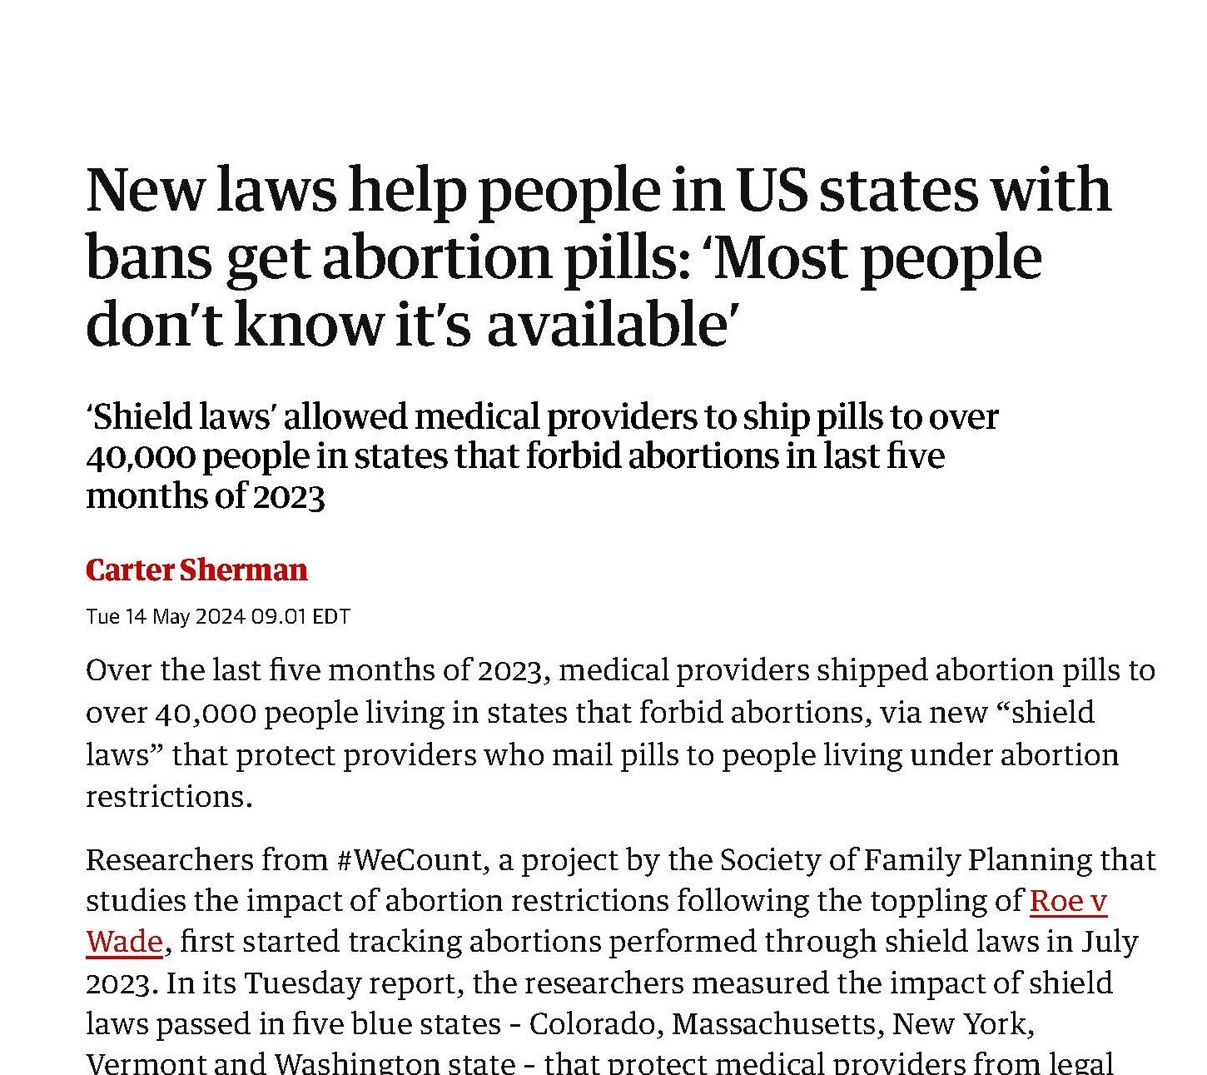

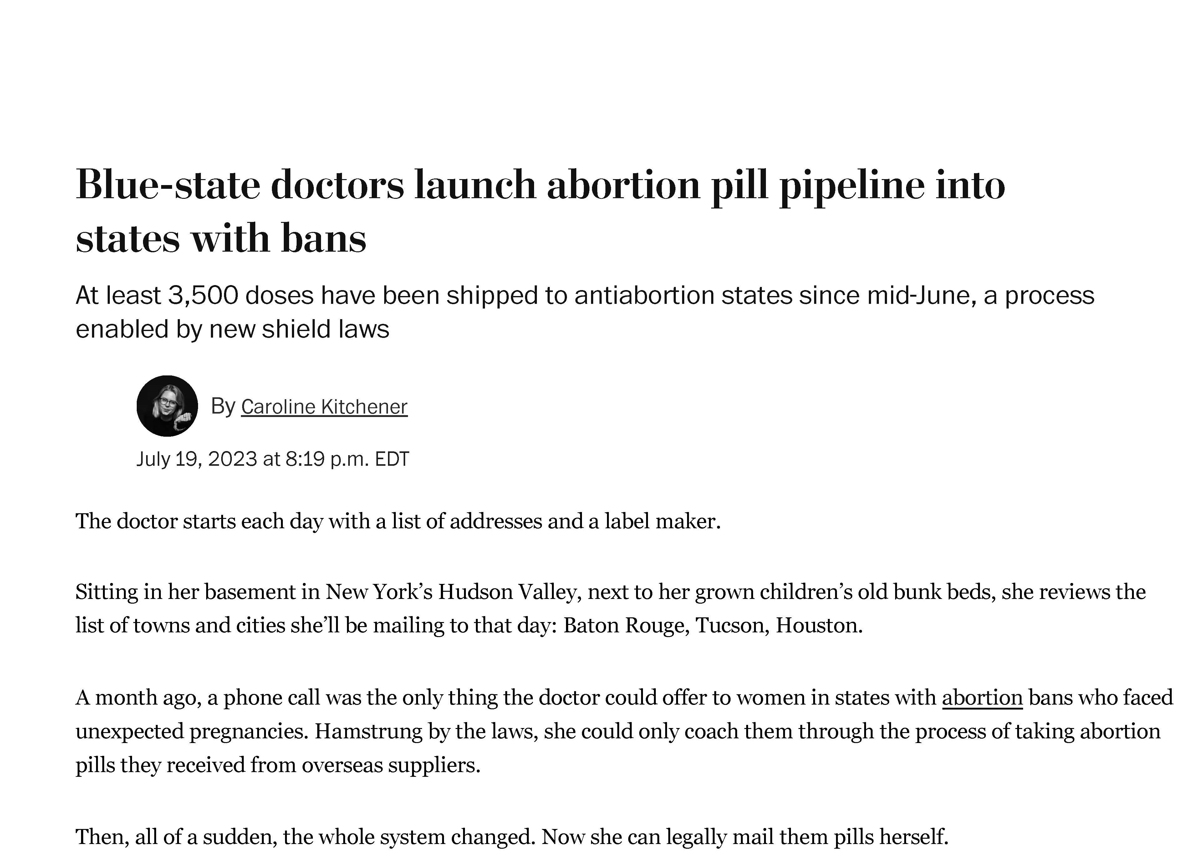

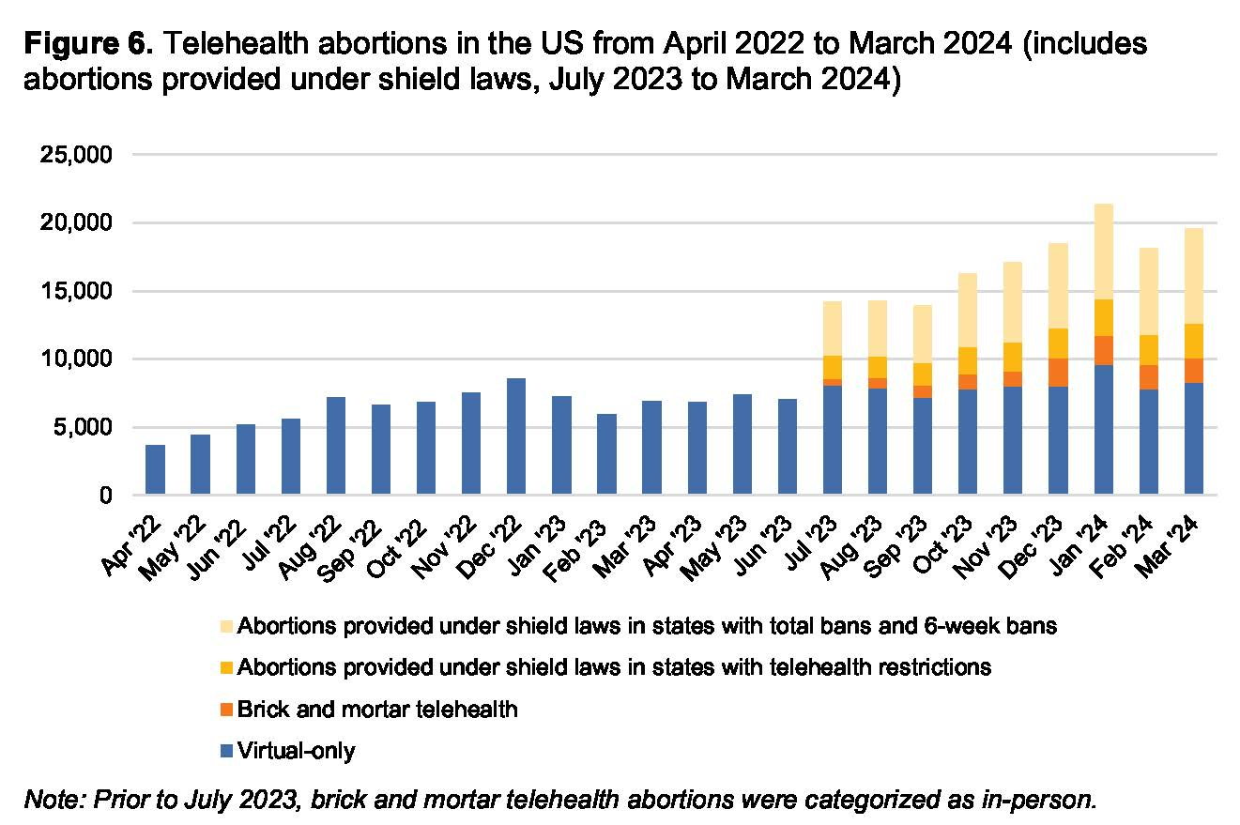
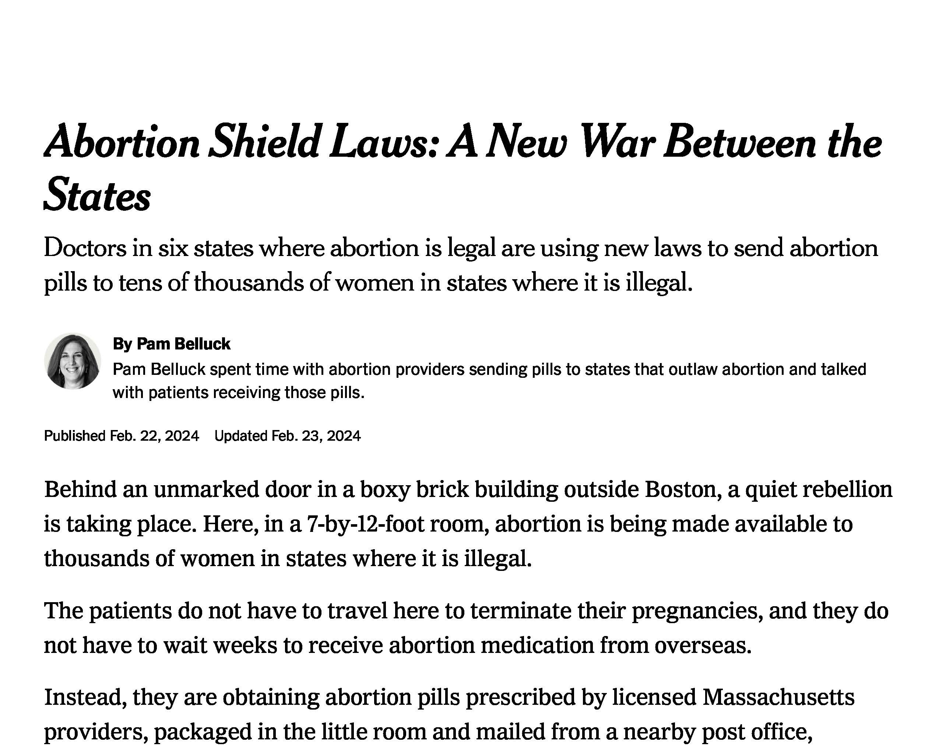

Over 6,700 monthly telehealth abortions are provided under shield laws to people in states with total or 6-week abortion bans.
Source: Society of Family Planning, #WeCount Report, April 2022 to March 2024, Released August 7, 2024
Notes:
Under the protection of shield laws, providers in shield law states are now providing abortions into places where it’s prohibited.
Aid Access is located outside of the US.
A patient in a restrictive state can initiate an encounter –video, audio-only, or asynchronous messaging. If patient is eligible, the provider prescribes medication abortion and mails it to the patient. If the patient has any questions, the providers are available to answer questions.
To be clear, this is illegal under the laws of the state where the patient is located.
#WeCount started tracking these kinds of abortions last summer. Latest report shows 6,700 per month into ban states.
Does not provide state-specific information to protect patients and providers

Slide 8
Understanding Shield Law Limitations
Notes:
Shield laws are important, but there are limitations and a lot of unanswered questions
Limited scope of protection – specific kinds of care that are provided in compliance with the protective state’s laws.
Unclear whether protection against unlicensed practice of medicine.
Protection only when physically located in the shielding state. Physicians have pledged to never step foot in certain states.
Shield laws are untested which leaves many unresolved questions –full faith and credit, state-based licensure, impact of electronic and automatic sharing of medical records across states,
No cases yet.
Texas AG sought records from children’s hospital in Washington related to gender affirming care. Case settled.
“threaten basic principles of comity between states, possibly resulting in the breakdown of state-to-state relations and ultimately retaliation.”

Slide 9
Ban State
Responses
Other Potential
Developments
Abortion trafficking laws
Abortion fund litigation
Abortion medication restrictions
Local government actions
Abortion medication approval
Comstock Act enforcement
Notes:
Ban states want to prevent travel
Idaho and Tennessee – abortion trafficking laws
prohibit an adult from assisting (recruiting, harboring, or transporting) a minor in getting an abortion without parent’s consent, including helping minor obtain a legal abortion in another state.
Both laws have been enjoined.
Many states have tried to ban abortion medication but haven’t been successful.
Louisiana rescheduled abortion medication as a Schedule IV controlled substance. Bill introduced to address abortion coercion, but testimony emphasized telemedicine abortion.
Alabama and Texas – ongoing litigation about whether state can prohibit organizations that provide financial and logistical assistance
Local ordinances authorize civil lawsuits against individuals who help someone travel for abortion care. Builds on Texas SB 8.
Investigation and enforcement against women who seek abortion care out of state – fetal remains, child endangerment, etc.
Other potential challenges/ developments related to interstate care
FDA v. Alliance for Hippocratic Medicine – challenging approval of Mifepristone and, more broadly, whether courts can reverse FDA approvals.
SCOTUS dismissed suit for lack of standing. Status quo for now, but more challenges to come. If challenges are successful, could limit access to medication nationwide.
Future administration could potentially revive Comstock Act of 1873, prohibits mailing of materials for abortion
Current DOJ says it won’t enforce Comstock because the Act only applies when the sender intends for the mailed material to be used for an illegal abortion, and because there are legal exceptions in every state, it is impossible to determine the intent of the sender.

