Slide 1
Physician Unions
ASMAC Fall Conference
October 2024
Notes:
Good afternoon! I’m here to talk to you about Truth in Advertising.

Slide 2
AMA policy on physician unions
Supports the right of physicians to engage in collective bargaining
Supports expanding the definition of “supervisor”
Encourages physicians who engage in advocacy activities to avoid forming unions with workers who do not share physicians’ primary and overriding commitment to patients
AMA Code of Ethics prohibits engaging in any strike that involves withholding essential medical services from patients

Slide 3
AMA Research: practice ownership is declining
49.7% of physicians were employed in 2022
Notes:
The number of physicians who own their own practice is going down. In 2022, only about 47% of physicians owned their practice, down from 60% in 2012. This means more and more physicians are employed. In 2022, about half of all physicians were employees according to AMA data. Other surveys show this number as considerably higher. In any case, this means you’re more likely than ever to work as an employed physician.
This means you must navigate contracting in a consolidated world where health plans and employers have bargaining power.

Slide 4
Unionization Landscape
AMA estimates that 11,000+ physicians and physicians in training joined unions in 2023 and 2024
Skyrocketing among residents
Committee of Interns and Residents (CIR) represents 20% of medical residents
Up from 10% in 2019
Growing among employed physicians
6.3% of physicians, 7.1% of surgeons union members in 2023
Up from 5.7% in 2014
More are covered under union contracts

Slide 5
Unionization Landscape
Residents and Fellows | Employed Physicians
Northwestern University | Allina - Minnesota & Wisconsin
Mass General Brigham - Boston | Salem Hospital (Mass General Brigham)
University of Pennsylvania | Cedars-Sinai Anesthesiologists
Montefiore Medical Center | Southern Oregon – ED Physicians
Stanford Health Care
University of Southern California - Keck
UChicago

Slide 6
Unionization Landscape
Residents have been successful in negotiations around wage increases, health insurance, retirement contributions, parental leave, and work hours.
Ripple effect to non-union institutions: E.g., 8-week parental leave
Employed physicians cite staffing levels as a primary driver of unionization
Note nursing unions in the news as systems can’t meet the staffing ratios to which they agreed
Research of all healthcare unions suggests that unionized healthcare workers have higher weekly earnings and better noncash benefits (e.g., pension and employer-paid full-premium health plan), but higher weekly work hours—for physicians, no significant difference.
Notes:
https://jamanetwork.com/journals/jama/fullarticle/2799909

Slide 7
“Supervisor” status
Piedmont Health Services Medical Providers United (2022), 10-RC-286648, Decision and Direction of Election (DDE): physicians are not supervisors under the NLRA simply by virtue of their position in the healthcare institution. physicians will not automatically be considered supervisors under the NLRA.
ALLINA HEALTH D/B/A MERCY— UNITY CAMPUS (2023), 18-RC-312132: a Chief of Staff and member of the Medical Executive Committee was not a supervisor, in part because she did not make final decisions on the hiring process and did not have the authority to impose discipline.
NLRA “requires … evidence of actual supervisory authority visibly translated into tangible examples demonstrating the existence of such authority.”
“The evidence must be detailed and specific, particularly with respect to the factors weighed or balanced in exercising putative supervisory authority, in order to establish independent judgment.”

Slide 8
Outstanding considerations
What is the scope of negotiations – can unionization help physicians address the moral injury?
E.g., physicians often express interest in negotiating terms of insurance contracts
Are there conflict of interest concerns where unions include non-physicians (e.g., NPs/PAs)?
What leverage and bargaining power to avoid interruptions in patient care? (AMA CEJA is researching)
What is the role of the medical society?

Slide 9
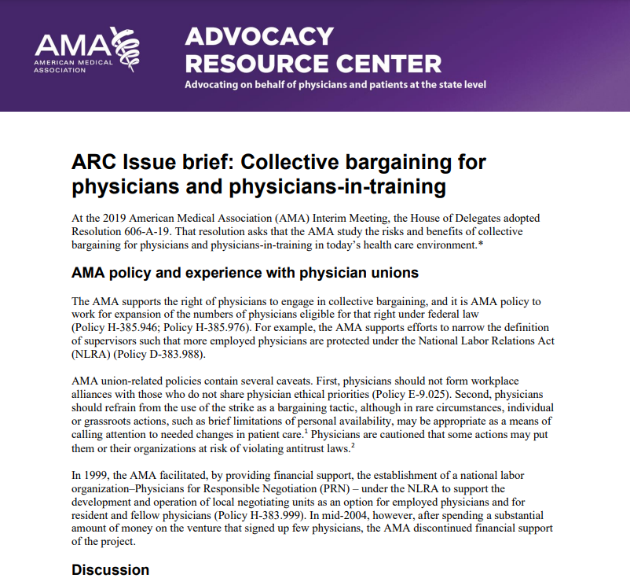
AMA Advocacy Issue Brief – Physician Unions
Find AMA’s Advocacy Issue Brief on Collective Bargaining here: https://www.ama-assn.org/system/files/advocacy-issue-brief-physician-unions.pdf

